Slide 1


Ubuntu Development Primer
How to stop monkey patching and start committing
Dave Chiluk – chiluk@ubuntu.com

Slide 2
chiluk.
Dave Chiluk
Ubuntu Core Developer
Currently
  Linux Platform Engineer for Indeed.com
Previously
  Canonical - Engineering Support for Ubuntu Advantage
  IBM - Linux Technology Center
https://wiki.ubuntu.com/chiluk

Slide 3
Topics
Getting support
Launchpad
Modifying Sources
Building
Submitting changes
stretch Topic – Ubuntu Kernels

Slide 4
Why you might care!
Self-maintained packages.
Desire to give back to the community
Tired of the maintenance burden of one-off packages
Mentorship beats reading wiki pages
(but there will still be plenty of pages)
Outdated documentation

Slide 5
Where do you go for support?

Slide 6
Where do you go for support?
google.com
askubuntu.com
ubuntuforums.org
Ubuntu Advantage – Paid support through Canonical
IRC – Freenode
  #ubuntu – General User support
  #ubuntu-devel – If you have a fix and need sponsorship or guidance
  #ubuntu-bugs – Specific bug related discussion
Launchpad
  This is not a forum. Keep all conversations technical and on topic.

Slide 7
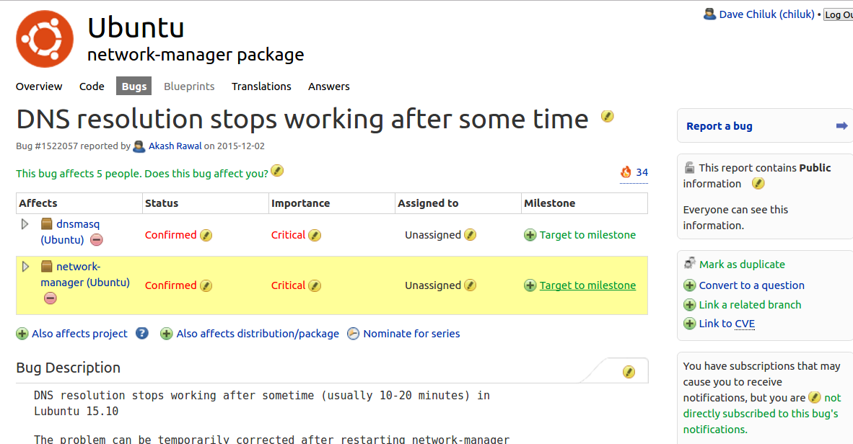
Launchpad.net
So you found your bug on launchpad?
Click this affects me too
Notes:
Double check the bug description
- does the reproducer apply to you? Click affects me too
- This will change Status → confirmed
- Is it against the correct package?

Slide 8
Launchpad.net
So you found your bug on launchpad?
Click this affects me too
Notes:
Double check the bug description
- does the reproducer apply to you? Click affects me too
- This will change Status → confirmed
- Is it against the correct package?

Slide 9
Launchpad.net
Subscribe yourself

Slide 10
Launchpad.net
Assign yourself if you have a fix or are pretty sure you’ll get one. Unassign yourself If you give up.

Slide 11
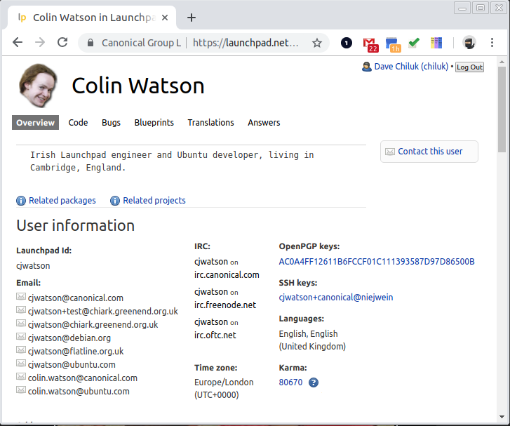

Launchpad.net
All of these result in Karma.
x

Slide 12
What if there’s no related bug?
Is your package up to date?
Include
  Logs?
  Debug output (using --verbose or --debug flags)
  Memory dump?
Test Ubuntu development packages?
  Bisect/backport if it’s fixed there.

Slide 13
What if there’s no related bug?
Create one by using the ubuntu-bug utility
  $ ubuntu-bug <affected package>
  This will package up a number of logs, and create a bug for you

Slide 14
Fix it
Check upstream?
  If fixed
    Backport the change
  If not
    Fix it in the upstream project first
Submit it back into Ubuntu

Slide 15
Submitting it to Ubuntu
Get the sources
Create the patch
Edit the changelog
Build it
Test it
Submit a debdiff
Test it some more.

Slide 16
Getting the sources
Get the tools
  $ sudo apt install sbuild debhelper ubuntu-dev-tools devscripts build-essential fakeroot kernel-wedge kernel-package dpatch quilt
rmadison <source package name>
  Shows the version of the package in every supported version of Ubuntu
mkdir bash
pull-lp-source bash bionic

Slide 17
The debian directory
changelog
rules - Makefile
control – package definition, including depends, build-depends, recommends, and replaces.
patches/
  Patches because Ubuntu is a delta applied on top of Debian, and this helps when new versions need to be brought into Ubuntu
  From before Git was created
patches/series
$ what-patch
https://wiki.debian.org/Packaging

Slide 18
Demo
rmadison
pull-lp-source
debian directory

Slide 19
Create the patch - quilt
quilt top
  What is the current patch we are at
quilt push -a
  applies all patches
quilt new+add or quilt import
  Create a new quilt patch
quilt refresh
quilt header -e –dep3
Update Changelog (dch -i)

Slide 20
Create the patch - dpkg-source
Make changes
Update Changelog (dch -i)
dpkg-source --commit
  Creates the debian/patches file
  Adds it to debian/patches/series
  Launches text editor for filling out a dep3 Header

Slide 21
Edit the Changelog
dch -i
  adds a changelog entry
  Include description and LP#
  Follow format of other changes in the changelog
Double check that patch is listed in debian/patches/series

Slide 22
Demo
Edit bash
dch -i
dpkg-source --commit

Slide 23
Build the source package
debuild -d -S
  Signs the package with the key owned by the last editor of the changelog

Slide 24
Build the binary package
sbuild -A -d bionic-amd64 <new.dsc>
  https://wiki.ubuntu.com/SimpleSbuild
debdiff <orig.dsc> <new.dsc> > lp#.<series>.debdiff

Slide 25
Demo
dbuild -S
sbuild -A -j 8 -d bionic-amd64 bash_4.4.18-2ubuntu2.dsc

Slide 26

Test the Package
YES YOU!

Slide 27
Submit the change
Attach the debdiff to the launchpad bug
  $ debdiff <original.dsc> <fixed.dsc>
Is the patch for a released series?
  Fill out the SRU Template

Slide 28
Stable Release Updates (SRU)
https://wiki.ubuntu.com/StableReleaseUpdates
Copy the SRU Template to the top of the bug description and fill it out.
Helps reviewers understand what’s going on without having to wade through the entirety of the bug text

Slide 29
Sponsorship
Get Sponsorship – Core dev
  Subscribe ubuntu-sponsors to the bug
  Ask on #ubuntu-devel
  https://launchpad.net/ubuntu/bionic/+queue
Get SRU Sponsorship – SRU Team member
  Subscribe ubuntu-sru
Package is built by launchpad and added to the -proposed archive

Slide 30
Test it again!
Integration and build test
The original submitter is expected to test the package as it exists in -proposed.
verification-needed tag → verification-done
Wait 2-6 weeks for promotion to -updates

Slide 31
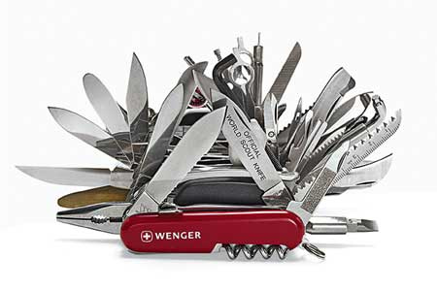
Submit to Debian
There’s a tool for that too!
  submittodebian
Why?
  Because we want to be good members of the Debian community,
  We don’t want to have to maintain an Ubuntu the delta indefinitely.

Slide 32
The Kernel
gitweb - https://kernel.ubuntu.com/git/ubuntu
git clone git://kernel.ubuntu.com/ubuntu/ubuntu-bionic.git
Git Branches
  master
  master-next – kernel in -proposed being tested.

Slide 33
Building the kernel
make
  make oldconfig ; make
  for quick iteration
  Not recommended
alias fdr='fakeroot debian/rules' in ~/.bashrc
$ fdr prepare-generic
  creates config
$ fdr binary-generic
  build portable deb packages

Slide 34
For New fixes
Submit to Upstream Kernel
Documentation/process/submitting-patches.rst
Then submit to linux-stable
  Will be automatically applied to Ubuntu kernels if they cleanly apply

Slide 35
Cherrypicks of Upstream patches
Test Upstream
  https://wiki.ubuntu.com/Kernel/MainlineBuilds
  http://kernel.ubuntu.com/~kernel-ppa/mainline/
git bisect to find correct upstream commit.
git cherry-pick -sex <upstream commit>
Submit the cherry-picks to linux-stable
  Documentation/stable_kernel_rules.txt
This will eventually get included into Ubuntu via linux-stable patch streams
Consider HWE kernels (linux-*-hwe*).

Slide 36
Other fixes
Sauce Patches - patches that are not accepted by stable, but are still needed in Ubuntu
Submit to kernel-team@lists.ubuntu.com
Follow patch submission guidelines
  https://wiki.ubuntu.com/Kernel/Dev/KernelBugFixing

Slide 37
Questions please
Thank you
Dave Chiluk
chiluk@ubuntu.com
irc: chiluk

